Slide 1




About me
I’am having high interest in Data Analysis, I’m taking Bootcamp Data Science from Dibimbing because of that.
I am already and currently learning about:
I learn and note them on my github.com/syaerulid

Slide 2

My Project
Predict Home Loan Approval
https://github.com/syaerulid/Home-Loan-Recommendation
Anaylsing Factors that Lead to Employee Attrition
https://github.com/syaerulid/Employee_Attrition

Slide 3

Employee Attrition and Factors Syaerul Rochman

Slide 4
Table of contents
01
02
03
04
Background
EDA + Data Preprocessing
Business Problem
Exploratory Data Analysis, Standardized the Data
Feature Engineering
Processing Data before Machine Learning
Modeling + Recommendation
Modeling this Dataset and Give Business Recommendation

Slide 5
Background
01
Attrition is the departure of employees from the organization for any reason (voluntary or involuntary), including resignation, termination, death or retirement.

Slide 6
Business Problem
What are the factors that most Influence Employee to do Attrition
How to Minimize Attrition on Employee with High Position?
Why Minimizing Attrition Rate is Important?
This is because high employee attrition can negatively impact a company’s culture and morale. Team dynamics will became unstable, and work environment gonna be hostile.
Losing Empoyee with (High Position) or Valuable can demoralize the staff that still stay in the company, that’s why minimizing their Attrition is Important.

Slide 7
What do we want to Achieve?
Modeling
Analysis
Recommendation
Getting model with Great Metrics Score
(> 0.8) that can predict Employee Attrition
Analyze each employee based on the factors that most influence the Attrition Decision
Giving Business Recommendation related to the Analysis Result

Slide 8

Data Preprocessing
02

Slide 9
PreProcessing Steps
1st
2nd
3rd
Collecting Data
Looking for Features that most Correlated with Attrition
Only Using Column from the result of 2nd Process
4th
Last
Cleaning Data
(Missing Values and Duplicated)
Adding new Features based on default Features for better Data Understanding

Slide 10
Dataset Information
These data Consists
With 35 Features
1470 Rows
Age
Attrition (Our Target)
Business Travel
Daily Rate
Department
Distance From Home
Education
Education Field
Employee Count
Employee Number
Environment Satisfaction
Gender
Hourly Rate
Job Involvement
Job Role
Job Satisfaction
Marital Status
Monthly Income
Monthly Rate
NumCompaniesWorked
Over 18
Over Time
Percent Salary Hike
Performance Rating
Relationship Satisfaction
Standard Hours
Stock Option Level
Total Working Years
Training Times Last Year
Work Life Balance
Years at Company
Years in Current Role
Years Since Last Promotion
Years with Current Manager
that have no duplicated and Missing Value

Slide 11
Dataset Process
Features | Correlation Score
Total Working Years | -0.171063
Job Level | -0.169105
Years in Current Role | -0.160545
Monthly Income | -0.159840
Age | -0.159205
Years with Curr Manager | -0.156199
Stock Option Level | -0.137145
Years at Company | -0.134392
Job Involvement | -0.130016
Job Satisfaction | -0.103481
Environment Satisfaction | -0.103369
From Data Before, we got
1470 Rows
that have no duplicated and missing Value
With 19 Features
Age
Attrition (Our Target)
Business Travel
Department
Education Field
Environment Satisfaction
Gender
Job Involvement
Job Level
Job Role
Job Satisfaction
Marital Status
Monthly Income
Over Time
Stock Option Level
Total Working Years
Years at Company
Years in Current Role
Years with Current Manager
We use Features that most correlated with thresold min 0.1/-0.1 for more efficient analysis
And create new Features called “Age Range” based on Age

Slide 12
Exploratory Data Analysis
03

Slide 13
Numerical Distribution Univariate Analysis

Slide 14
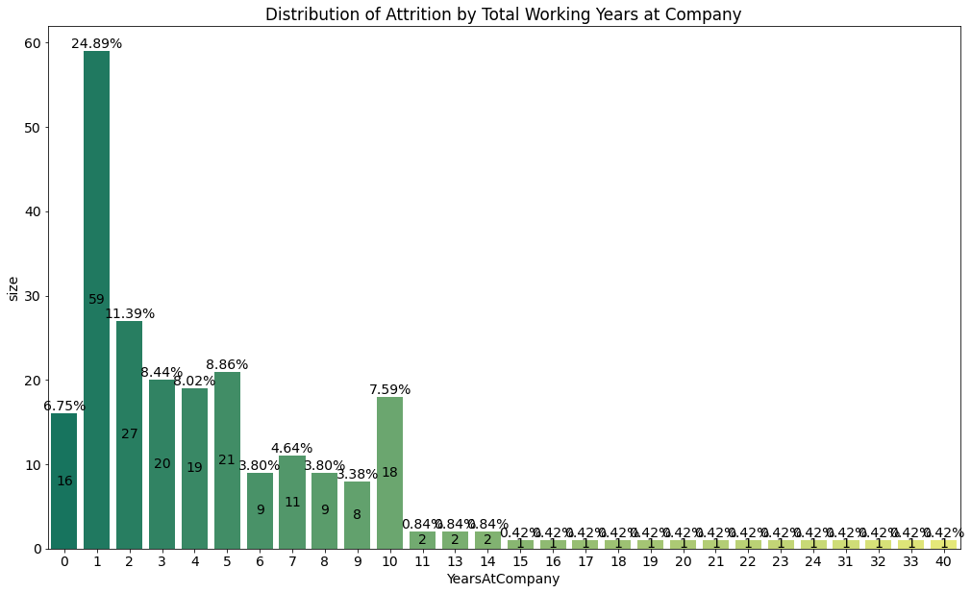
Distribution of Attrition Based on Total Working Years
Conclusion :
1. If an Employee lasts at least the first 2 years at the Company, the possibility of Attrition for that Employee will decrease
2. Employees who decided to Stay at least the first 2 Years will work at least until their 10th Year
3. Employees who decided to not do Attrition in their 10th Year, have a very small chance of Attrition
- In 0th year of Work, Number of Employee that decided to Attrition is not that big, `just a little over 5%` from total All Attrition Employees
- In the 1st year of working at the company, the number of employees that decided to Attrition is very high until reached `24.89%` of the total all Attrition Employees
- Year 2 Attrition decreased significantly to 11.39%
- After the 2nd year, the distribution of employees Attrition is always below 10%
- There is an Unusual Increase in Attrition in Year 10 of working at the Company

Slide 15
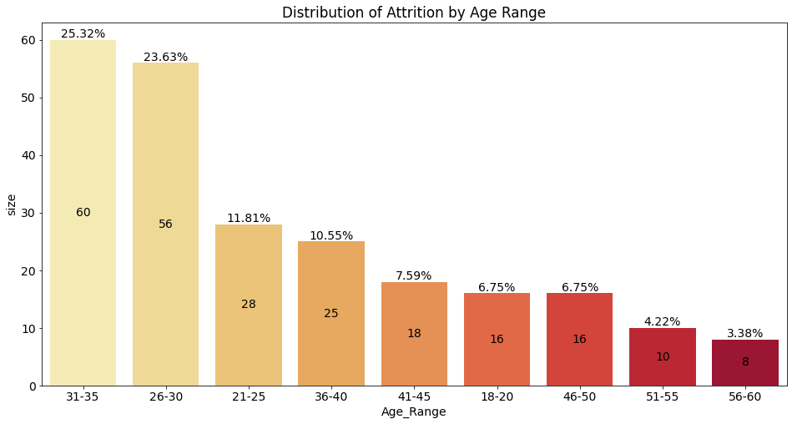
Distribution of Attrition based on Age Range
- First Position on the Distribution of Attrition Employee is Group Age `31-35` with 25% from All Employee that decided to Attrition
- Second Place is Group Age `26-30` with only 2% slight difference
- Apart from the `18-20` Group Age, All Group Age > 40 Years have Attrition percentage below 10%

Slide 16
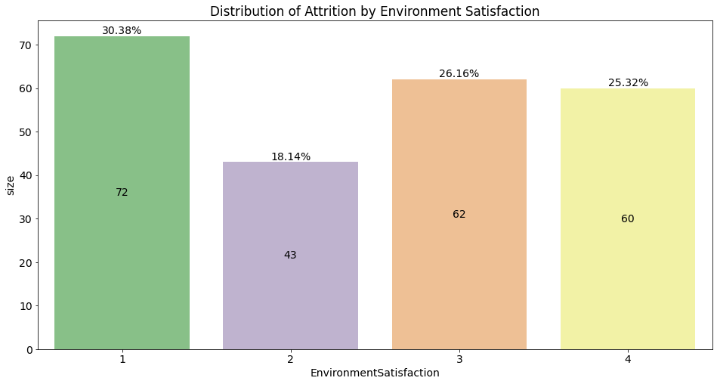
Distribution of Attrition Based on Job Involvement
Employee with Job Involvement 3, dominated the Attrition Employee, more than 50% that Attrition is having this Job Involvement
Attrition distribution in Job Involvement 2 and 1 is decreasing around 20%
Job Involvement 4 have very low Attrition

Slide 17
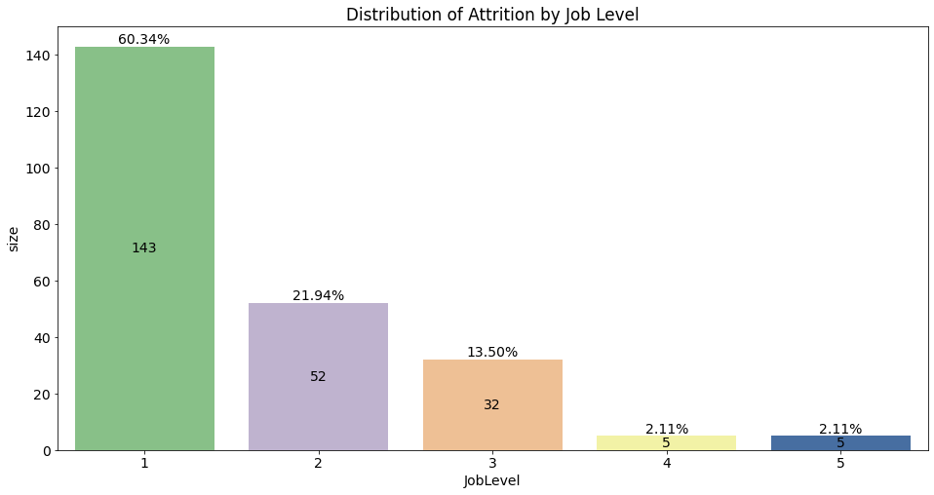
Distribution of Attrition Based on Job Level
- Employees with Job Level 1 (Entry Level), dominate the distribution of Attrition reaching 60%,
`Notes`: Job Level 1, is the level for Entry Level / Fresh Graduate, meaning that it is possible that young people dominate this level
- Employees with Job Level 2 (Intermediate) still have a rather decent amount of around 21%
- Employees who reach Job Level 4 and 5, have a very small possibility of Attrition

Slide 18
Distribution of Attrition Based on Environment Satisfaction
Environment Satisfaction also same with Job Satisfaction, its has fairly even distribution, and doesn't really affect Attrition decisions

Slide 19
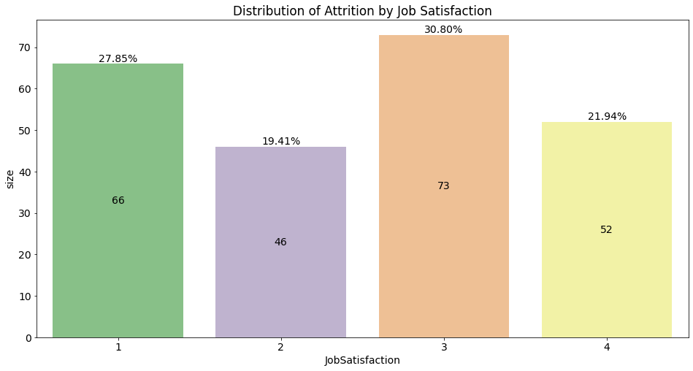
Distribution of Attrition Based on Job Satisfaction
Job Satisfaction has a fairly even distribution, and doesn't really affect Attrition decisions

Slide 20
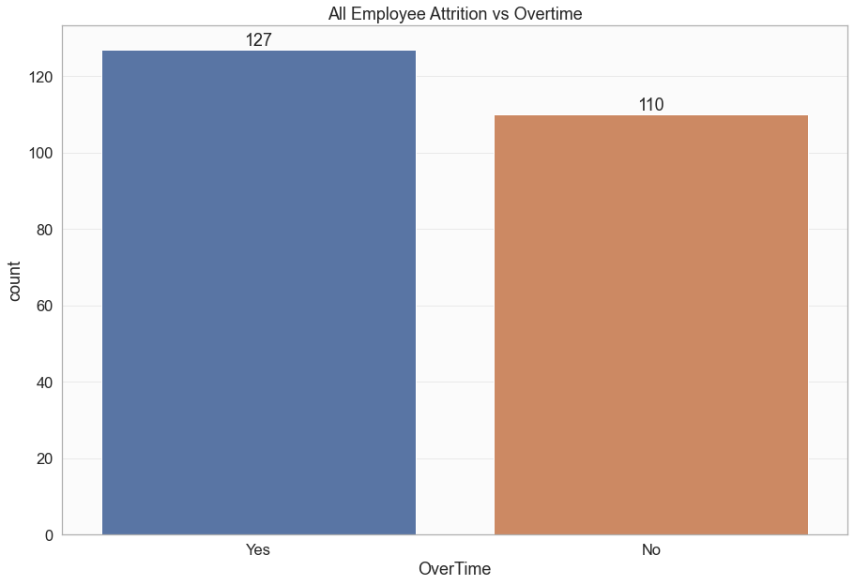
Distribution of Attrition based on Overtime

Slide 21
Numerical Distribution Bivariate Analysis

Slide 22
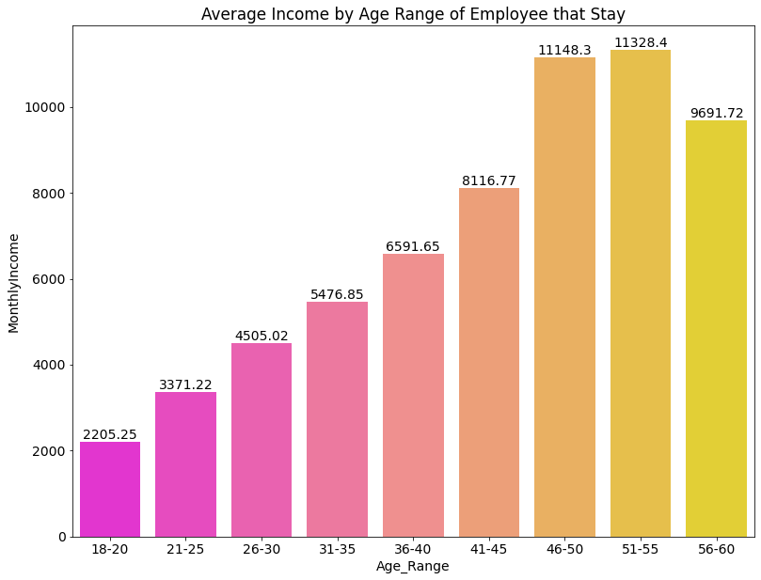
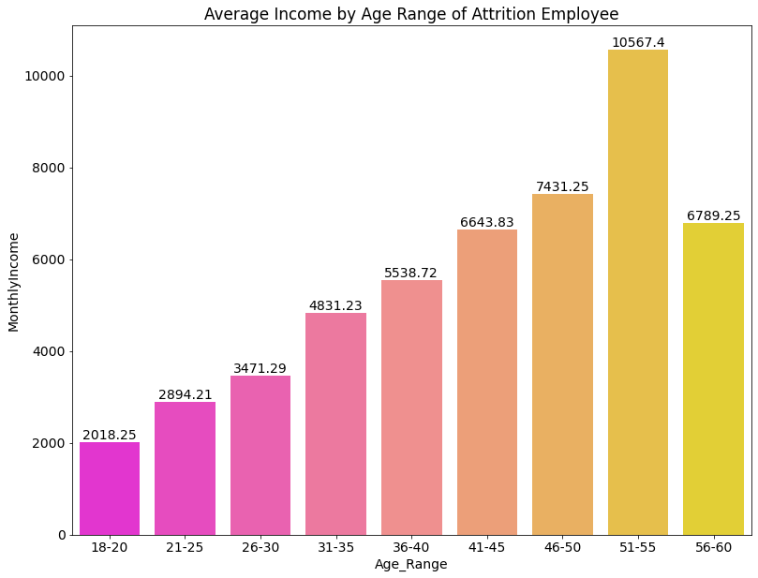
Average Income of Employee Grouping by Age Range
Average Income Outlook for Employee that Decided to Stay
There is a difference in Income from the start in the 18-20 age group (Between Stay and Attrition), although the difference is not that big
This difference in average income continues to increase and the most significant are in the 46-50 and 56-60 groups
Employees who stay and are in the 46-50 age group have an average income difference of 4000 compared to those who decide on Attrition
From the 51-55 to the 56-60 age group there is only a slight decrease in income, for employees who decide to stay, in contrast to employees who end at Attriton, there is a drastic decrease in income in this group (this difference can be seen in the graph below this)
Average Income Outlook for Employee that decides to do Attrition
Income always increases with increasing age (related to the longer working time at the company)
There is a drastic increase in Income of 3000 from the Age group 46-50 to 51-55
After a drastic increase There is a drastic decrease in Income from 51-55 to Age 56-60

Slide 23
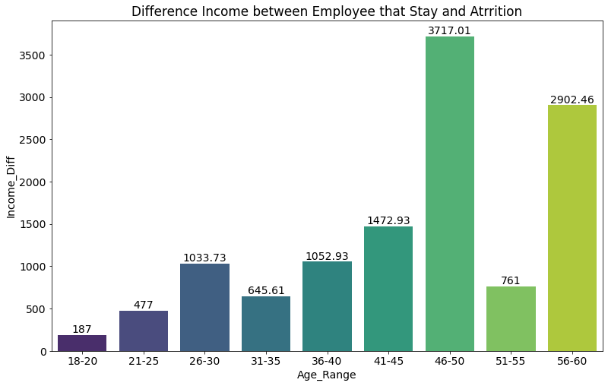
Difference Average Income Stay vs Attrition
The most group ages who decided to Attrition were 26-30 (23.63%) and 31-35 (25.32%)
However, it can be seen here that the difference in income between employees who stay and decide to quit is not too significant. The biggest difference is even in the Group Age 46-50 and 56-60 which do not provide a significant Attrition rate only 6.75% for Group Age 46-50, and 3.38% for Group Age 56-60.
In conclusion, Income is not the main reason of someone deciding Attrition or not.

Slide 24
Question
and Further Analysis

Slide 25
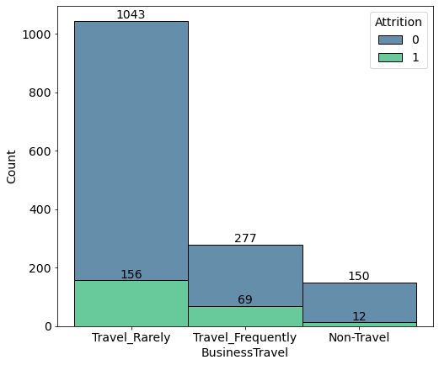
1. Does Business Travel Have Impact on Attrition?
Employees who Travel Frequently are proven to have a greater Tendency to Attrition, this statement supported by the data, that said around (69 out of 277 Employees) or 25% of the total Employees who Travel Frequently.
Meanwhile for Employee that Rarely Travel, Percentage of Attrition dropping down, from 25% to 15%, there's 10% difference.
Last, for Employee that Never Travel, Percentage of `Attrition` dropping again, and its only 1/3 from Employee that Frequently Travel, from 25% to 8%, its amazing drop
NOTE : Although we can see, from the chart that Employee who Rarely Travel have more Quantity in terms of Attrion compare to Employee Frequently Travel, but this is a *misunderstanding*, because the percentage of 'Attrition' is higher high for employees who frequently travel even though in this data only 69 people or 4.6% of the total number of employees.
However, If:
*Total Employees who Travel Frequently = Total Employees who Rarely Travel*
**Then, there will be (25% x 1043 = 260) Employees who (Travel Frequently) that tend to do Attrition

Slide 26
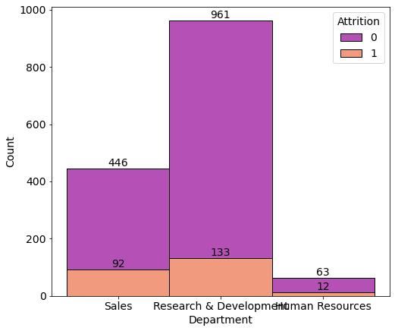
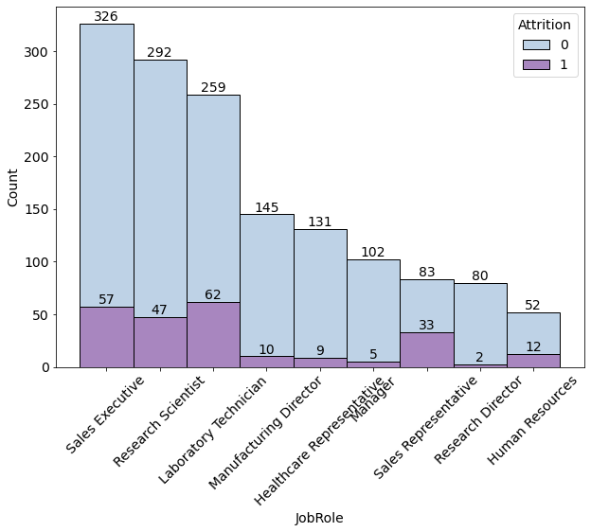
2. Tendency to do Attrition, Based on Department and Job Role
Sales Department has an Attrition tendency of 20%
The R & D department has an Attrition tendency of 13.8%
The HR department has an Attrition tendency of 19%
Unique isn't it? The department that looks the most out of the total employees 133/1470 or 9%, turns out to have a smaller Attrition tendency
Sales Executive by 17%
Research Scientist by 16%
Laboratory Technician by 23%
Manufacturing Director of 6.8%
Healthcare Representative of 6.8%
Managers by 4.8%
Sales Representative of 39%
Research Director of 2.5%
HR of 23%

Slide 27
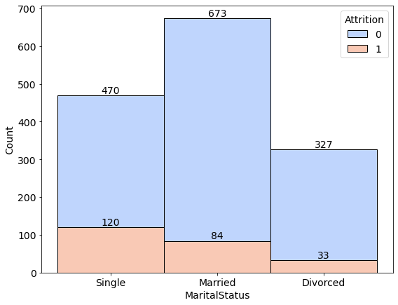
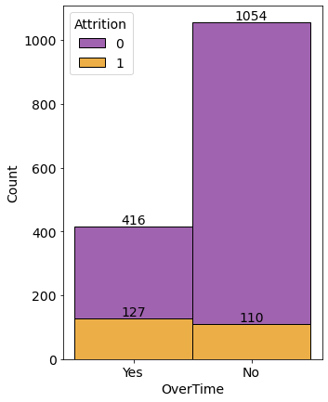
3. Tendency to do Attrition, Based on Marital Status and Over Time
Single Employee have 25% Tendency to do Attrition
Married Employee have 12.4% Tendency to do Attrition
Divorced Employee have 10% Tendency to do Attrition
The tendency for Attrition is owned by employees whose workload is still small or still single, for employees who are married the percentage of attrition decreases by 50% compared to employees who are still single. Then divorced employees have a smaller percentage than those who are married
Overtime by 30%
No Overtime by 10.4%
working hours have a significant impact on an employee's decision whether to do Attrition or not, as evidenced by employees who work Over Time have a percentage for Attrition 20% higher than those who don't

Slide 28
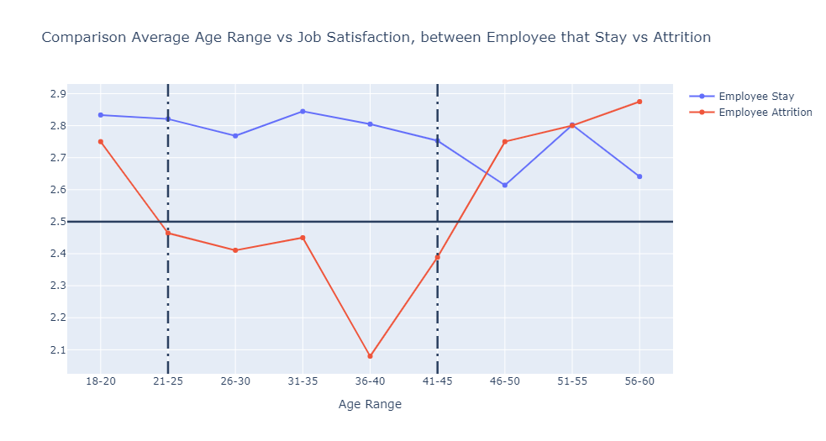
Age Range vs Job Satisfaction
As we can see, with 2.5 as a threshold for average Job Satisfaction, we can conclude that:
Employee Group that have Job Satisfaction below 2.5 have higher chance for Attrition
This conclusion is supported by the Distribution of Attrition by Age Range Group below.
Group Age that have the most Attrition are :
21-25 (11.81%)
26-30 (23.63%)
31-35 (25.32%)
36-40 (10.55%)
This data distribution is based from Total Employee that decided to Attrition.

Slide 29
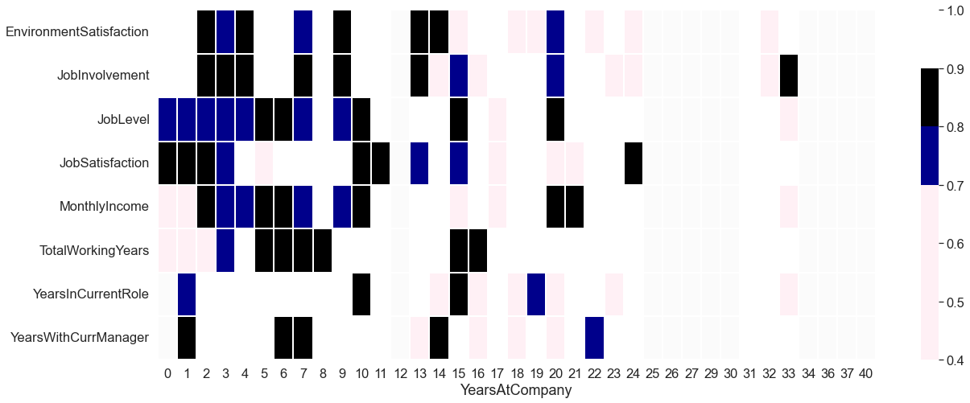
Years in Company vs Numerical Data
Notice something with Blue and Black:
Job Level have High Impact, Especially for the first 8 Years in the Company
Job Satisfaction have High Impact, Especially for the first 4 Years in The Company
Monthly Income, Job Involvement and Environment Satisfaction is Important after Employee work for 2+ Years

Slide 30
After 10 Years Work
After 10 Years
- Job Satisfaction have the highest Impact
- Followed by Job Level and Monthly Income

Slide 31
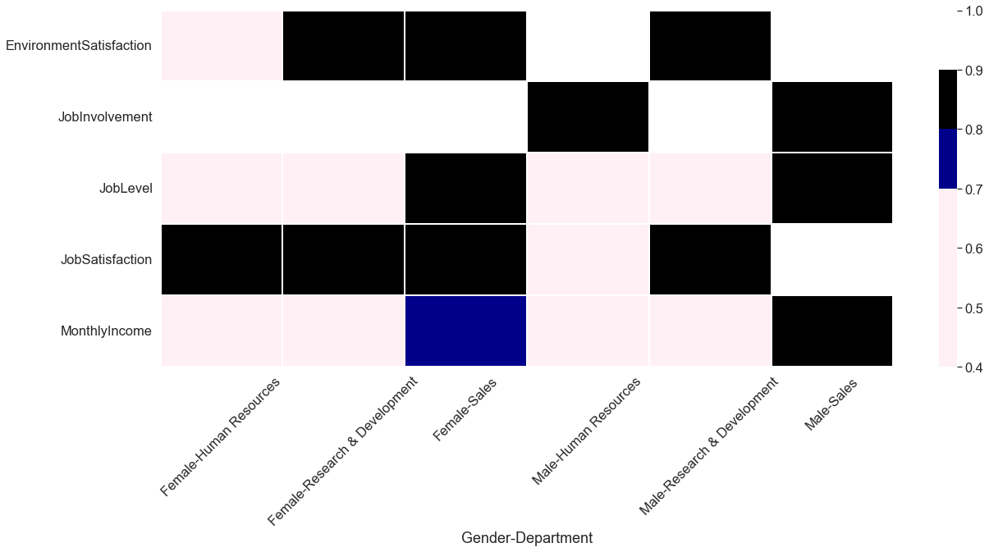
Gender and Department vs Numerical Data
Female:
For All Female Employee, Job Satisfaction is Really Important
Almost All Female Employee, except HR, think that Environment Satisfaction is very Important
For Female Sales, All part is important except Job Involvement
Male :
For Male Sales, everything is Important except Environament and Job Satisfaction
Male R&D is opposite of Male Sales
For Male HR, Job Involvement is the one that really important

Slide 32
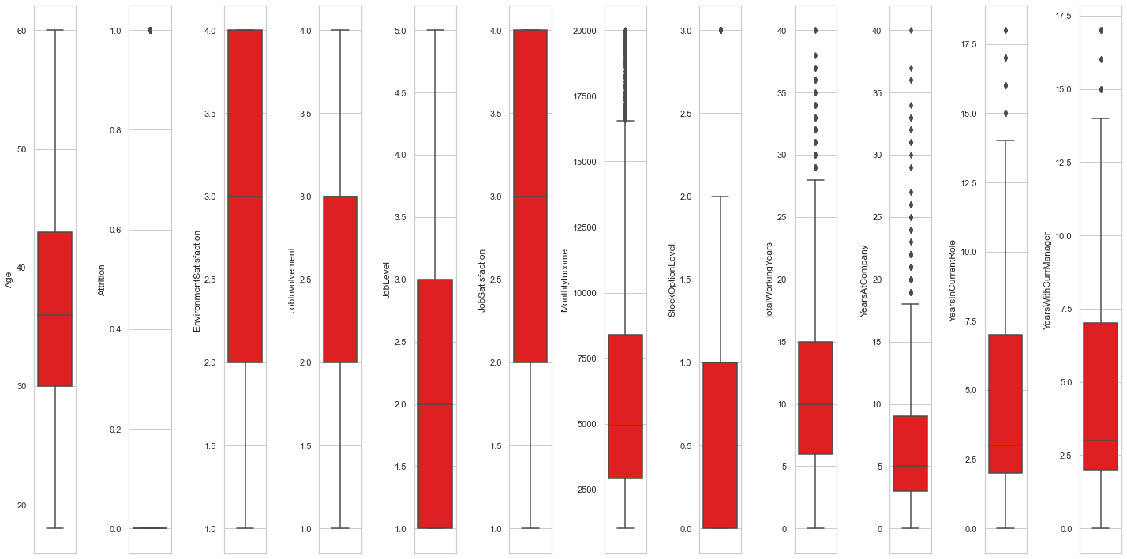
Outlier Handling
No Outlier to be dropped because all of them is make sense
We use Clip Upper and Lower based on IQR Instead

Slide 33
Feature Engineering and Column Drop
Label Encoding
Column
Column with 2 Distinct Values
Over 18 (Before Visualisation)
One Hot Encoding
Column 2
Column With 2+ Distinct Values
Job Level
YearsAtCompany
Years With Current Manager
(Before Modeling)

Slide 34
Modeling
04

Slide 35
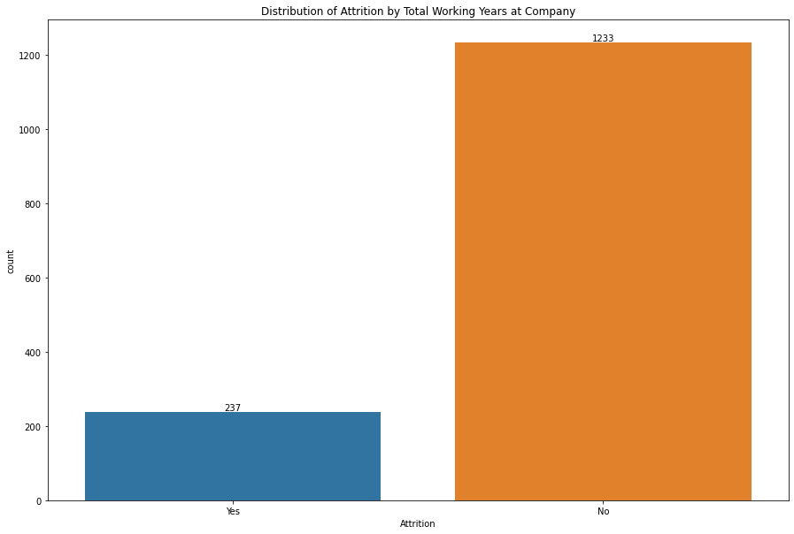
This Dataset is Imbalance
Because we want to prevent False Negative as much as possible
(When we think employee not Attrition, but they do Instead)
we will use Recall.

Slide 36
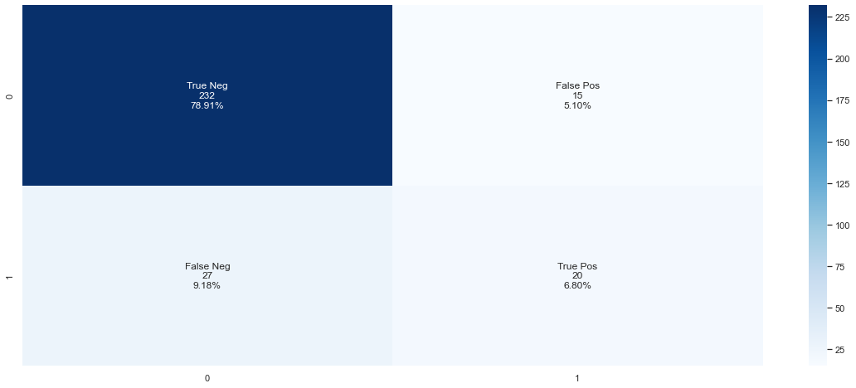
Baseline Model
Model | Recall | Precision | F1-Score
Logistic Regression | 0.148 | 0.7 | 0.56
Random Forest Classifier | 0.191 | 0.69 | 0.58
XGB Classifier | 0.42 | 0.57 | 0.68
With Recall As our key Metrics, this is very bad
Result
Even from Confusion Matrix, False Negative already
Low
But True Negative is Very High
(when we predict
Employee will Attrition and they do Instead)
After this we use KNN and Random Forest Tuning
But the result is much worse than this.

Slide 37
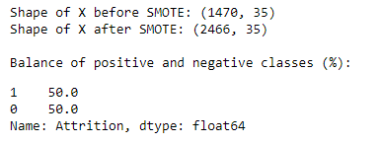
Oversampling with SMOTE
Model | Accuracy | Recall | Precision
Logistic Regression | 0.75 | 0.75 | 0.76
Random Forest Classifier | 0.90 | 0.90 | 0.94
XGB Classifier | 0.88 | 0.87 | 0.90
The only metrics that we need in Balanced Data is Accuracy
But we still need Recall Metrics for our modelling to lower the chance
of False Negative.
(when we think Employee is not Attrition but they do Instead)

Slide 38
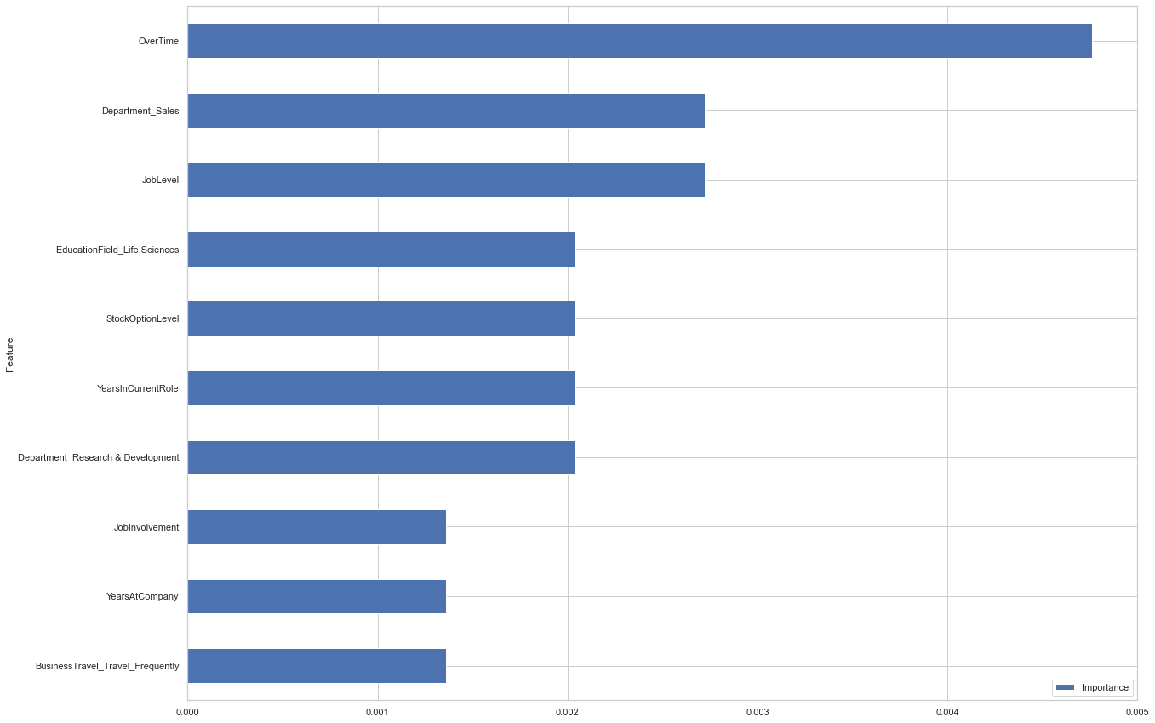
Features Importance Based on Random Forest Model

Slide 39
Business Recommendation
Try to reduce their Working Hours, because more than 50% of Employee that tend to Attrition is working Overtime, Especially Employee with Job Level 1
For Female Employee, try to Improve their Job and Environment Satisfaction since it’s the most important for them.
Try to give a test after 8 Years of work, for Promotion Job Level
For Employee in Sales Department (Female and Male) Try to Improve their Monthly Income

Slide 40
Thank you github.com/syaerulid

Slide 41


